Slide 1


Slide 2
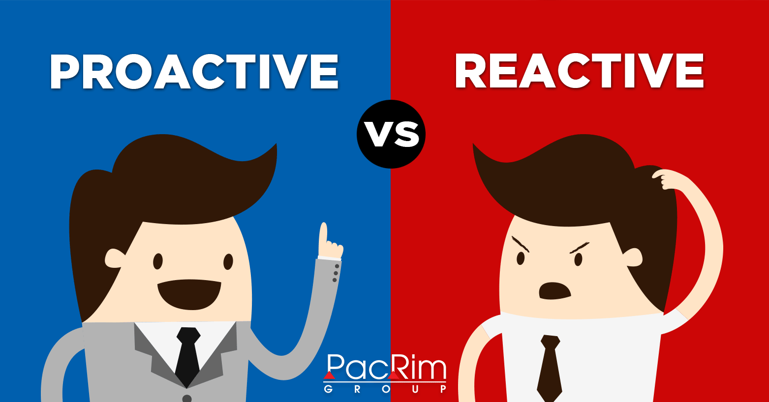

Slide 3

Process flow
Choosing
Algorithm for Task
Model training and testing
Data Acquisition and Data preparation
Side-technology: Team collaboration on GitHub https://github.com/BADS-NIDA/images-analytics

Slide 4
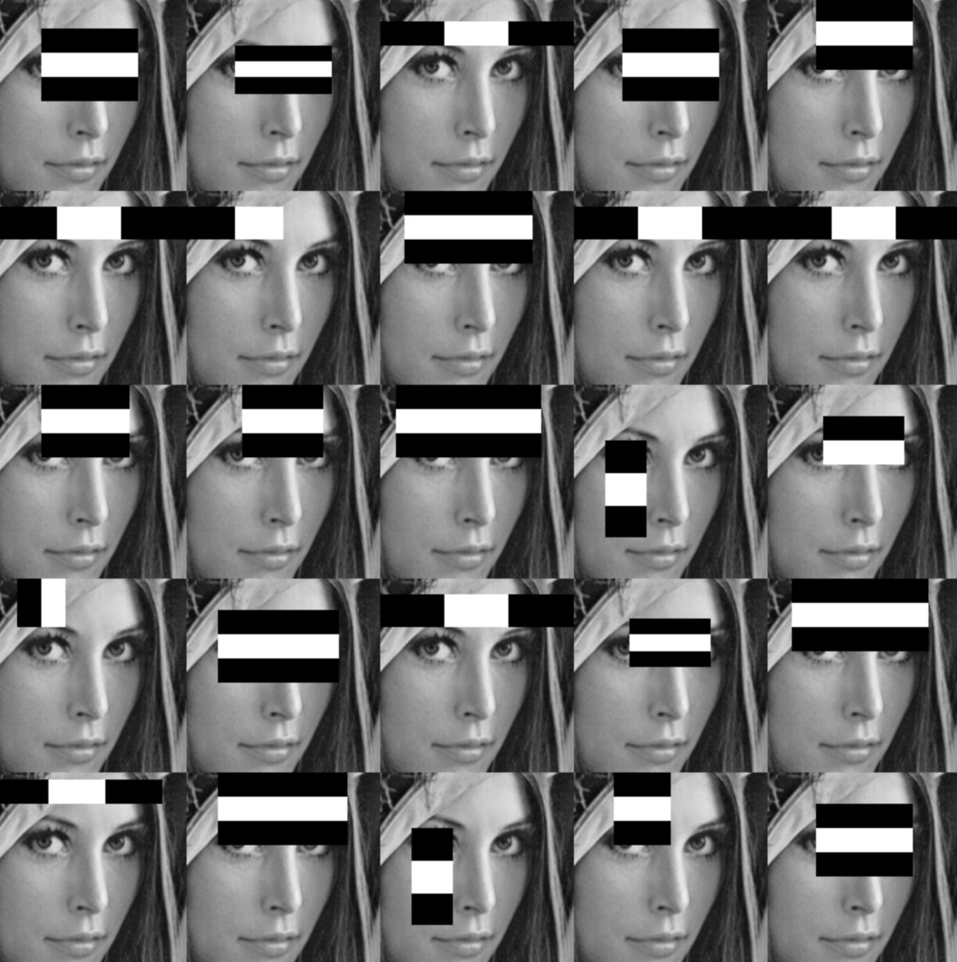


Choosing Algorithm
Goal: Good precision and Fast Detection
<

Slide 5
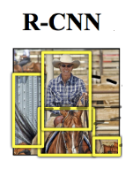

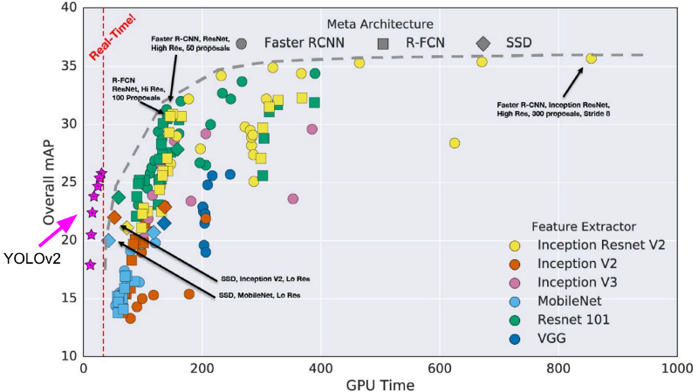
Choosing Algorithm
<
<
Speed!!!

Slide 6
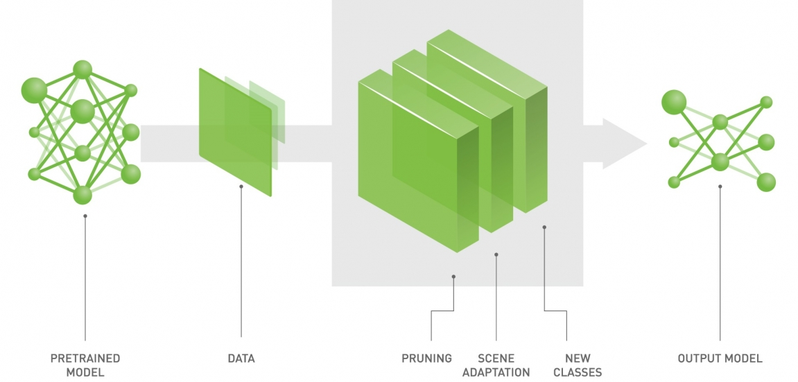
Choosing Algorithm
Transfer learning
Task Challenge: No interested class label

Slide 7


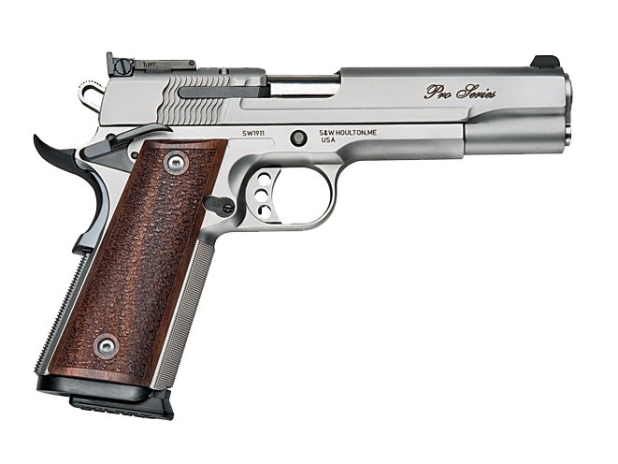
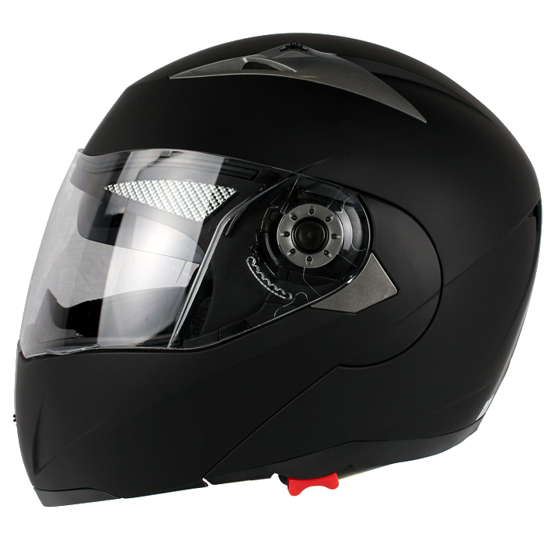



Acquiring Data

Slide 8
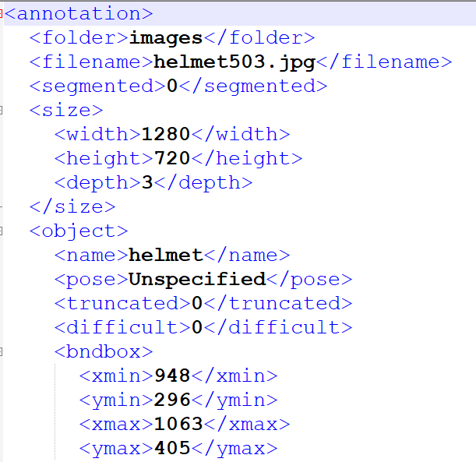
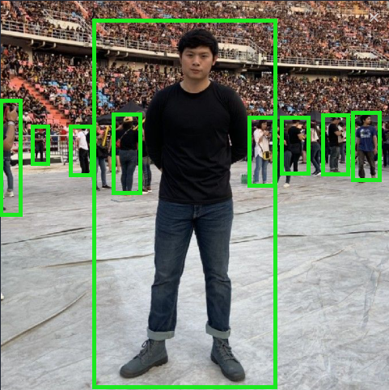
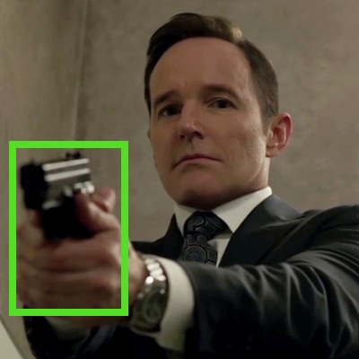
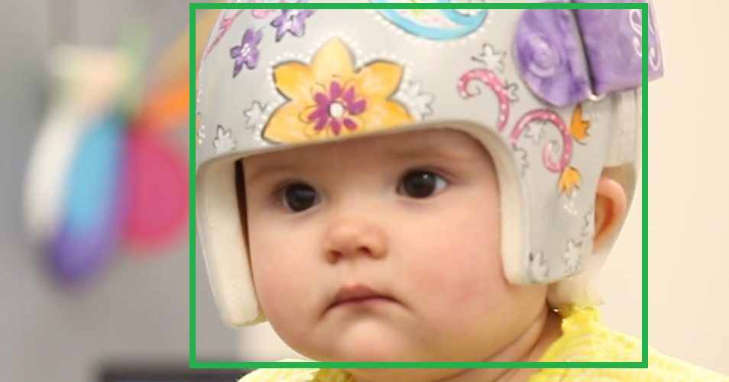
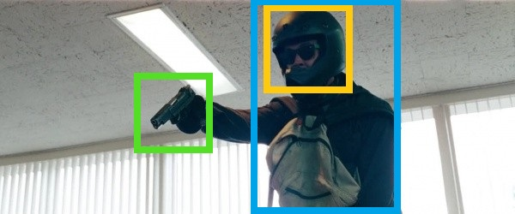
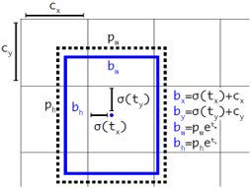
Data Preparation

Slide 9
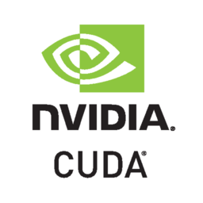

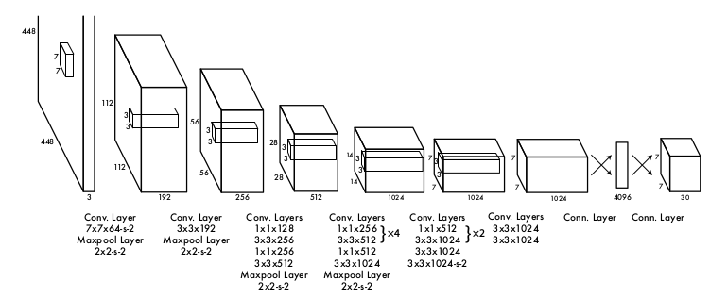
Training Model
Darkflow : Implementation of Darknet-YOLO framework with Python TensorFlow
TensorFlow: Python3.6, CUDA toolkit 9.0, cuDNN 7.4.2, TensorFlow 1.10
Pretraining model: VOC weight, tiny-yolo configuration

Slide 10
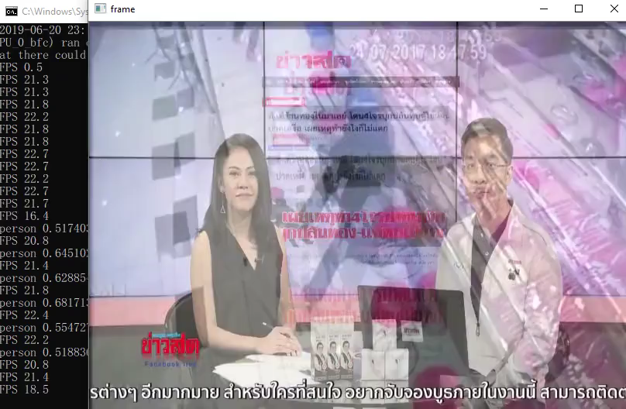
Results

Slide 11

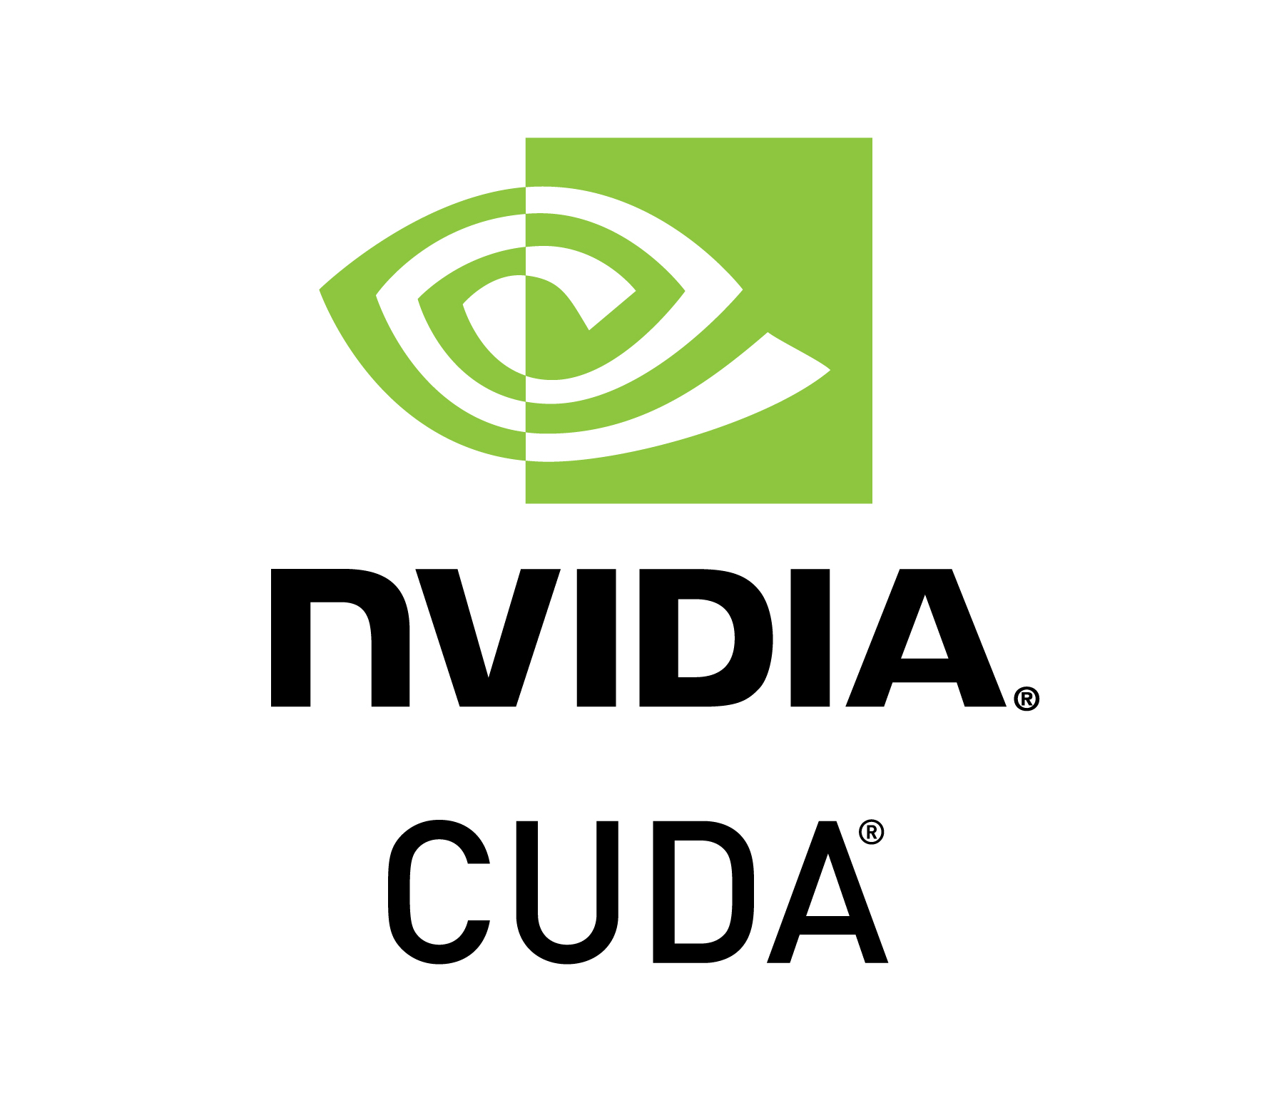
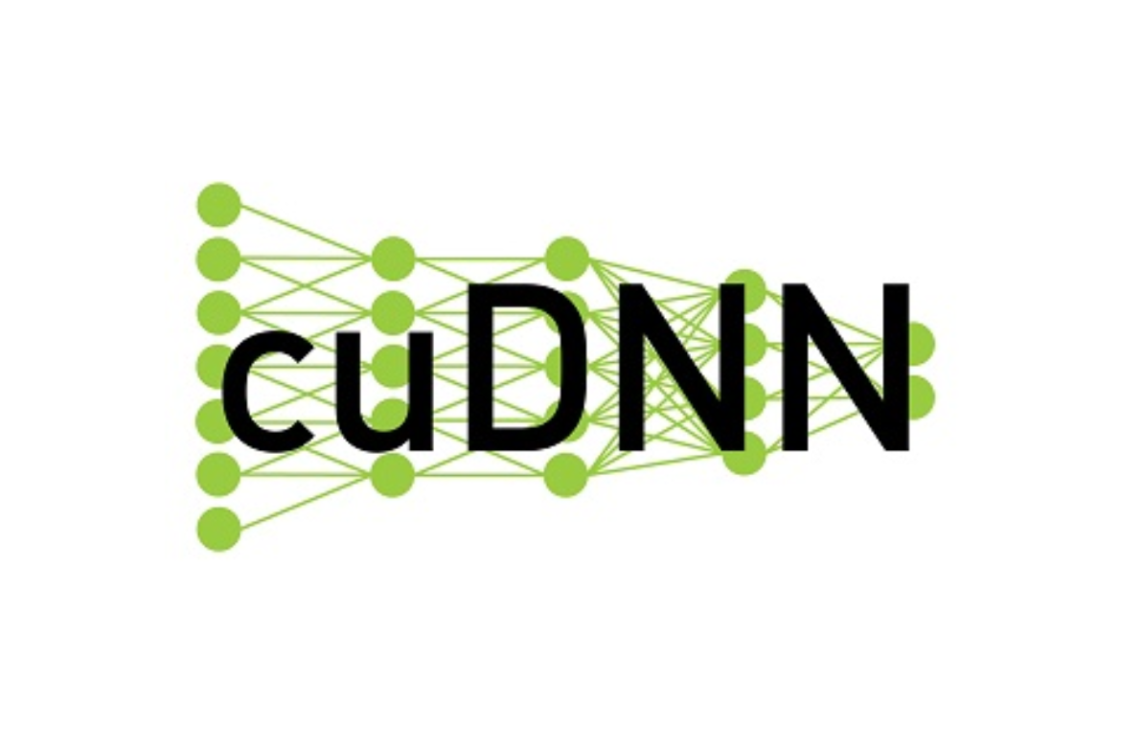

Problems
Solutions
Improvements
Tensorflow-gpu requirements
- CUDA, cuDNN versions
Darknet on windows.
Acquiring data
- ImageNet
- Google web scrape
No data with annotations
Low accuracy, false alarm
Limited computing power
Annotation format
conda install specific version
- Seperated environment
- CUDA, cuDNN, tensorflow
Darkflow
Multiple sources/keywords
BBox Label Tools
More and clean data
Tiny Yolo
XML
Tracking
Use only helmet full face to train model for better performance
Add Other face covering object, such as black glasses, mask
Add Other weapon object, such as knife , baseball bat
จะทำอะไรต่อยอดในอนาคตได้อีกบ้าง
Detection improvement by tracking
Handle occlusion
?? Other face covering object : mask, .. ?
?? Improve false alarm ??
?? Bounding box stabilization

Slide 12
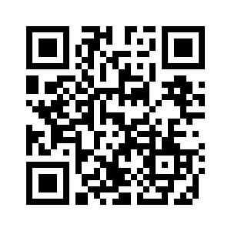
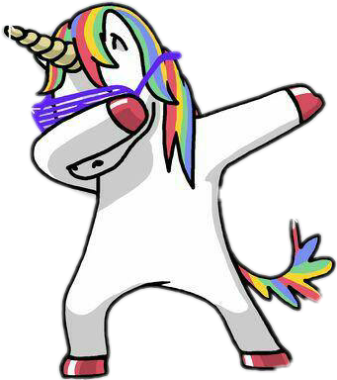
https://github.com/BADS-NIDA/images-analytics

Slide 13
รายชื่อสมาชิกกลุ่ม
นายนราชันย์ ปัญญาจักร
นายชลัช มงคลถิรภัทร์
นายอติเทพ กิติธีระกุล
นายธนา ธารารัตน์พิสัย
นายยงยุทธ ละมูลมอญ
61104220029
61104220032
61104220047
61104220054
61104220055

